Slide 1
Start Making Sense:
Writing the Accreditation Self Evaluation
Wanda Burzycki, Self Evaluation Co-Chair
PDA Workshop, August 16, 2013

Slide 2
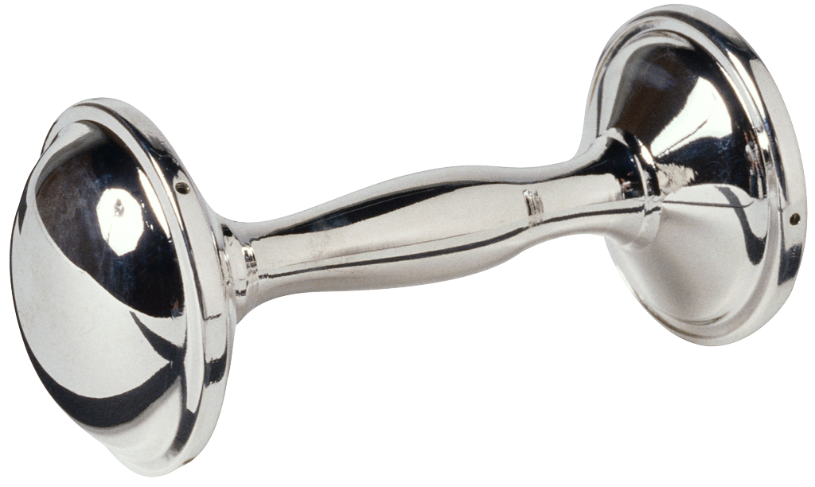

Slide 3
Today’s Outcomes--By the end, you’ll be able to:
Locate resources and information related to your standard section.
Use an organizing chart to deconstruct your standard.
Identify the three parts of each Standard response section and the differences in development and content between each.
State your next step and when and where you will accomplish it.

Slide 4
Current status?
What have you done?
What do you want to do next?
What do you need?

Slide 5
Resources and Information
SRJC Accreditation 2015 Website:
http://www.santarosa.edu/accreditation2015/index.php
(or go to “Quick Links” on SRJC homepage)

Slide 6
ACCJC Publications
http://www.accjc.org/
(or through “ACCJC Resources” link on
SRJC Accreditation 2015 homepage)
Guide to Evaluating Institutions
Guide to Evaluating Distance Education and Correspondence Education
Manual for Institutional Self Evaluation

Slide 7
Suggestions to Prepare for Writing (Prewriting)
1. Parse the language of the standard you are working on and break it into questions.
Example: Standard II.A.1.c (Instructional Program):
The institution identifies student learning outcomes for courses, programs, certificates, and degrees; assesses student achievement of those outcomes; and uses assessment results to make improvements.
Notes:
Group tries parsing

Slide 8
Example
Standard
Deconstruction
The institution identifies student learning outcomes for courses, programs, certificates, and degrees; assesses student achievement of those outcomes; and uses assessment results to make improvements.
1. The college identifies SLOs for courses
For programs (at SRJC, majors, pathways; student services covered in IIB)
For certificates
For degrees (majors)

Slide 9
(continued…)
Standard
Deconstruction
The institution identifies student learning outcomes for courses, programs, certificates, and degrees; assesses student achievement of those outcomes; and uses assessment results to make improvements.
2. The college assesses:
Courses
Programs
Majors (degrees)
Certificates
3. The college uses assessment results to make improvements.

Slide 10
Now ask the questions:
Has the college identified SLOs for courses?
How do you know?
Has the college assessed those SLOs? To what degree? And how do you know?
Has the college identified SLOs for majors?
How do you know? Etc.
Does the college use assessment results to make improvements? How? What evidence do you have?

Slide 11
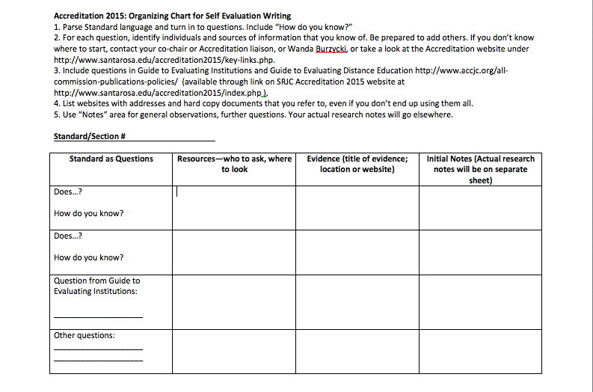
Transfer questions to a graphic organizer
Example of organizing chart

Slide 12
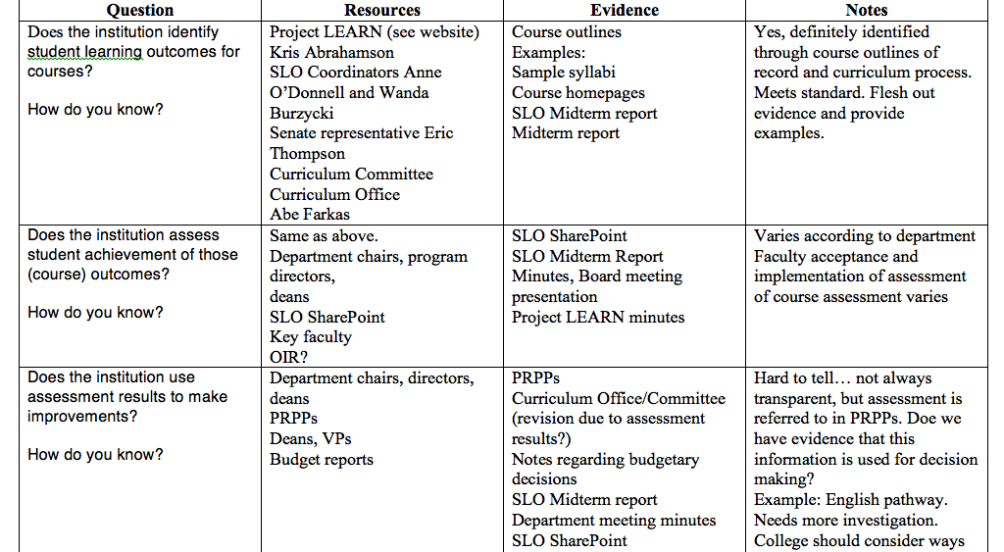
Example

Slide 13
One month and many pages of notes later…

Slide 14
Become familiar with the structure
Descriptive Summary
Self Evaluation
Actionable Improvement Plans
Each part of the response to the standard requires a different approach and different, but related, content.

Slide 15
1. Descriptive Summary
A descriptive overview of what the institution does in relation to that standard.
Example: “As of April 2011, SRJC has identified SLOs for all active courses. SLOs are created as part of the curriculum development and revision process, which by definition requires department dialogue. Course submissions are reviewed at the Cluster level, which allows for further discussion…” etc.
This section gives the facts and refers to sources.

Slide 16
When writing the descriptive summary:
Suggestion: Organize related topics under subheads. This will help you group the information in your notes. Example:
Course SLOs and Assessment
Major and Certificate SLOs and Assessment
Assessment as Part of Institutional Improvement
Also, use charts and graphs as needed to illustrate information.
This is an area you can write on your own, based on your notes.
It is better to have more details and explanation at this point than to try to over-summarize.
If the writing flow eludes you, start by listing related facts.
Be sure to record sources of evidence, which will need to be reffered to in the text and listed at the end of that Standard response.

Slide 17
Self Evaluation
Feel free to write up your evaluation based on your observations and the evidence, but…
Your committee should read and discuss your descriptive summary to determine together—based on the variety of perspectives and knowledge—how well the college meets the standard. Based on this, you will draft the self evaluation section.
From pg. 21 of the Manual for Institutional Self Evaluation:
“…The basic questions to explore are whether or not, and to what degree, institutional evidence demonstrates that the institution meets the Standards and how the institution has reached this conclusion.”

Slide 18
More on the Self Evaluation Section
You and your committee should refer to the Rubrics for Evaluating Institutional Effectiveness—see Appendix B, pgs. 35-37, in the Manual for Institutional Self Evaluation and the ACCJC website under “Rubric…” at http://www.accjc.org/all-commission-publications-policies
The rubrics will help determine the level of compliance with the standard as well a provide language for the evaluation.

Slide 19
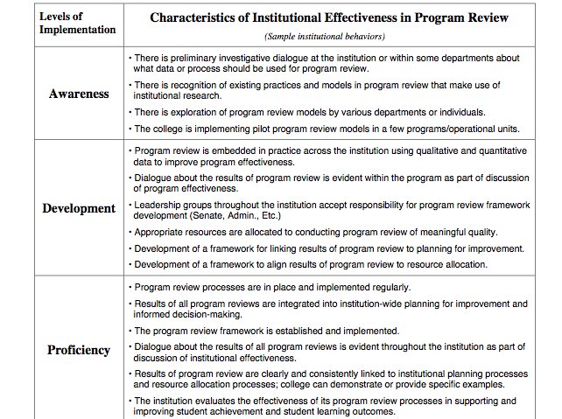
A sample of a rubric….

Slide 20
Sample of Self Evaluation Text (from SRJC 2013 SLO Report)
(Note evaluative wording, underlined)
“…Santa Rosa Junior College is at the “proficient” level of Student Learning Outcomes Assessment. As noted in items 1-7 above, the college meets the expectations of the Rubric for Institutional Effectiveness for SLOs. Faculty and staff in each department determine their ongoing, systematic cycle of assessment that must be posted in their Program and Resource Planning Process (PRPP) document. SRJC is in the third year of a six-year plan for course assessment, and the college is beginning its three-year plan to assess all certificates and majors.”

Slide 21
Actionable Improvement Plans
You as the writer may suggest areas that need improvement and change and how that might be accomplished. Feel free to share this with your committee.
Your committee will discuss whether efforts towards this goal are already implemented or whether the goal and plan should be included in the report.
The college is expected to respond to every stated Actionable Improvement Plan.
The Steering Committee will make the ultimate decision about which plans to include for each Standard.
Again, from pg. 21 of the Manual for Institutional Self Evaluation:
“…As an institution evaluates its program and services with reference to each Standard, it identifies areas in need of change. The Commission expects the institution to identify goals related to the areas that require change and decide on the action required to meet these goals.”

Slide 22
Examples of Actionable Improvement Plans
From Leeward Community College:
The dean of career and technical education will coordinate the development of a comprehensive assessment, review, and evaluation plan for OCEWD by the fall of 2013. This plan will include publishing SLOs and assessment results for all courses and programs in a location that can be accessed by the campus.
From Foothill Community College:
The academic senate along with the Office of Instruction & Institutional Research will continue to support and enhance the program assessments and a more formalized assessment cycle will be in place by Spring Quarter 2012.

Slide 23
Note: If appropriate, it is OK to write “None” under “Actionable Improvement Plans.”

Slide 24
Think you’re ready to write? Hold on….
Read examples of your section from other institutions that have had their accreditation recently reaffirmed. You should be able to access their reports fairly easily through their institutional websites. Suggestion: Leeward Community College.
You can find out which colleges had their accreditation recently reaffirmed through the ACCJC web page “Recent Commission Actions, Actions on Institutions”
http://www.accjc.org/recent-commission-actions

Slide 25
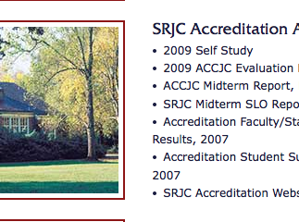
And make sure you’ve read…
SRJC’s 2012 Midterm Report
and 2013 SLO Report

Slide 26
Tips for Writing
Remember: “The ultimate inspiration is the deadline.” Don’t wait to feel better about working on this. Schedule your time now.
Turn to your co-chair, Administrative Liaison, and Wanda for information, clarification, and direction.
Don’t worry about the “professionalism” of your writing—things will be changed anyway. The important point is to offer plenty of documented information in a clear and organized fashion.

Slide 27
But a few style reminders…
Write in third person—that is, “The College” or “SRJC,” not “we” or “I.”
Spell out names of groups on the first reference, and use acronyms after that.
If you really know what you are talking about, you will be more direct in your language. Vague understanding leads to vague writing.
Use your colleagues for writing support.
From the Manual for Institutional Evaluation, pg. 40:
Be accurate. Nothing else matters if facts are not correct.
Be concise. Avoid jargon in text. Keep it as simple as possible.
Be specific, definite, clear and concrete. Explicit writing holds the attention of readers.

Slide 28
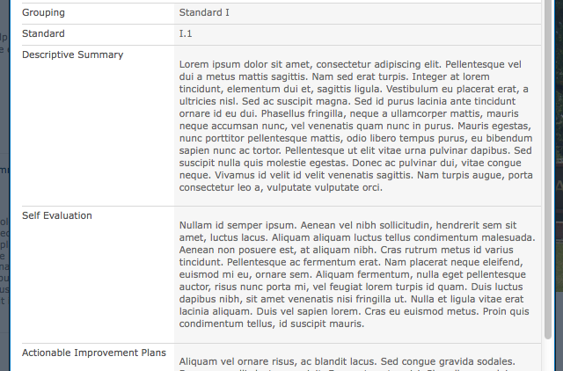
And when your draft is ready…
You can input it into the Accreditation SharePoint site to share with fellow committee members and get their feedback. Training to come soon! Check it out on the Accreditation homepage at http://www.santarosa.edu/accreditation2015/index.php

Slide 29
Questions?

Slide 30
Final questions for you:
What is your next step?
When and where will you begin that step?
What do you need to help you get there?
When is your next deadline?
Remember, I am here to support you. If you get stuck or overwhelmed, don’t wait till the last minute. Please contact me—we can work together to make this happen! Contact information is on the Accreditation 2015 website.

